Slide 1


DESIGN 1
Lesson 4: Building Your First HTML File
Ms. Abboud | Grade 9 - Design 1 | Term 1, Week 1

Slide 2
Learning Objectives
WALT - We Are Learning To
WILF - What I'm Looking For
To create and save a basic HTML file independently.
To apply correct file-saving conventions.
My file is created and saved correctly as index.html.
It displays correctly when I open it in a browser.
It contains a page title and at least one paragraph of text.

Slide 3
Academic Vocabulary
Syntax
The exact rules for writing code correctly, like grammar rules for HTML. Every opening tag needs a matching closing tag.

Slide 4
Frayer Model: Syntax
DEFINITION
CHARACTERISTICS
The exact set of rules for writing code correctly, like grammar rules for HTML (for example, every opening tag needs a matching closing tag).
A strict set of rules. Every opening tag needs a closing tag. Case matters.
SYNTAX
EXAMPLES
NON-EXAMPLES
Correctly closing </p>. Matching quote marks in an attribute.
Casual spoken grammar. A design choice like color.

Slide 5
National Identity Integration
UAE Digital Transformation and Future Skills: as you learn to build for the web this term, you're practicing exactly the kind of digital skill the UAE is investing in as it builds a future economy powered by technology and innovation.

Slide 6
STARTER
Quick recall: what do the letters H-T-M-L stand for, and why does a browser need it?
Hook - Engage & Ask
5 - 10 minutes

Slide 7
LESSON CORE
I Do: Teacher Demo
Watch your teacher build a new HTML file from scratch.
It will include a page title and a short paragraph of introduction.
Gradual Release of Responsibility
Example: teacher's index.html
30 - 40 minutes
<!DOCTYPE html>
<html>
<head>
<title>Ms. Abboud's Page</title>
</head>
<body>
<h1>Hello, I'm Ms. Abboud</h1>
<p>I teach Design 1 and love building things with code.</p>
</body>
</html>
1 / 4

Slide 8
LESSON CORE
We Do: Guided Practice
Follow along step by step to build your own basic personal HTML file.
This file becomes the first draft of your Personal Website Project.
Gradual Release of Responsibility
30 - 40 minutes
2 / 4

Slide 9
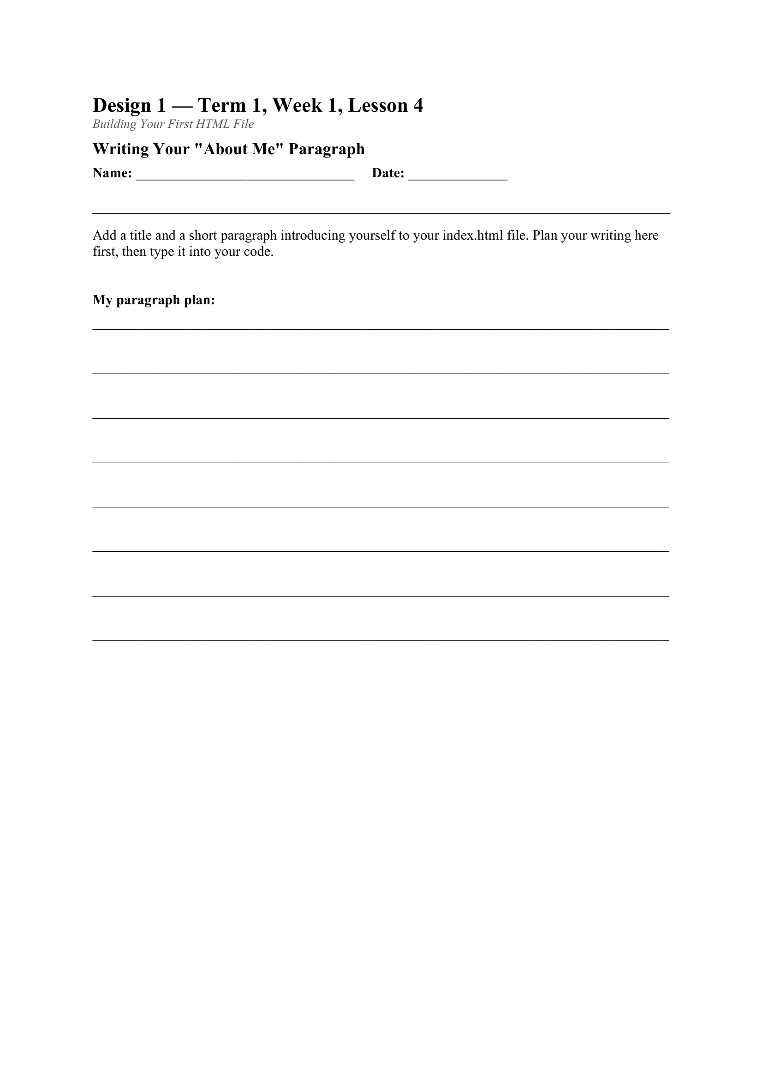
LESSON CORE
You Do: Your Turn
Create and save a new file called index.html.
Add a page title and a short paragraph introducing yourself.
Open it in your browser to check it displays correctly.
Gradual Release of Responsibility
30 - 40 minutes
3 / 4
Today's activity: the About Me Paragraph worksheet

Slide 10
LESSON CORE
Troubleshooting Common Errors
Forgot to save the file?
Wrong file extension?
Page not updating? Try a hard refresh (Ctrl+Shift+R).
Gradual Release of Responsibility
30 - 40 minutes
4 / 4

Slide 11
CLOSURE
Submit index.html to Toddle.
This is this week's formal formative check.
Transition & Extend
5 - 10 minutes

